Slide 1
AABG Guide to Amazon Web Services certification
10 DECEMBER 2021

Slide 2
Summary
Available AWS certifications
Exam prep resources
Obtaining Exam vouchers
Scheduling the exam
Reporting results

Slide 3
Available certifications

Slide 4
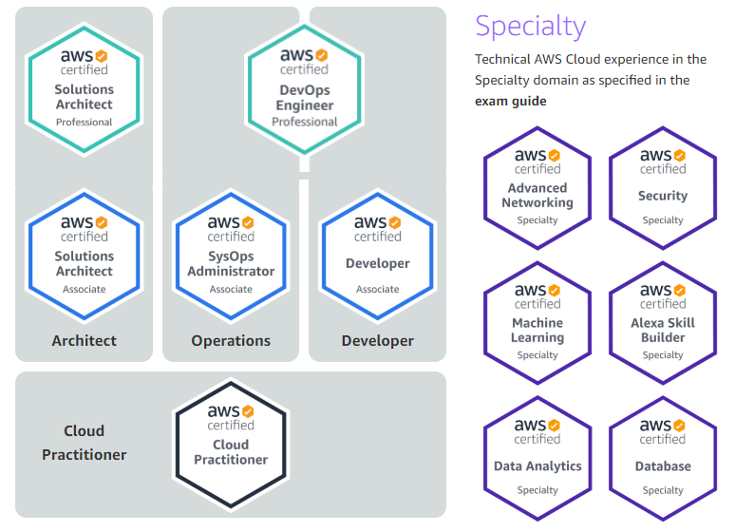
Amazon Web Services Certification Overview: Identify the type of certification you intend to pursue and review the Certification Overview below:
Certified Cloud Practitioner
Certified Solution Architect-Associate
Certified SysOps Administrator-Associate
Certified Developer-Associate-
AWS Certified Data Analytics - Specialty
AWS Certified Database - Specialty
AWS Certified Advanced Networking – Specialty
AWS Certified Security– Specialty
AWS Certified Machine Learning-Specialty
Certified Solution Architect-Professional
Certified DevOps Engineer-Professional
Certifications are valid for 3 years,
at which time they must be renewed.

Slide 5
Exam prep resources

Slide 6
How to Access AWS Preparation Materials
If you have not yet completed pre-requisite foundational training, please review the AABG Guide to AWS Training
Amazon Web Services provides access to a number of certification prep resources. You can access these at the following link: https://aws.amazon.com/certification/certification-prep/
These resources include:
Exam Guides for each certification
Sample question set for each certification
AWS Whitepapers on specific topics (https://aws.amazon.com/whitepapers/)
AWS FAQs on specific services (https://aws.amazon.com/faqs/)
AWS Free Tier Accounts:
You can establish an AWS account for hands-on practice via the Free Tier account program.
To create an AWS Free Tier Account visit this link: aws.amazon.com/free
If you have an AWS Account, you may be able to obtain service credits to support your preparation. Submit your request at this link for service credits: Service credit portal
Optional Exam Preparation
Whizlabs.com: Provides question banks/practice tests for each exam (NOTE: There may be a cost to the individual for this resource)

Slide 7
Obtain exam voucher

Slide 8
Overview of exam request process (this process is implemented effective 16 Dec 2020 to comply with Accenture Learning policy)
1. Register in myLearning
2. Obtain approval
3. Submit required information
4. Receive voucher
5. Schedule exam
Candidates will select the myLearning link for their target certification and submit registration request
For Cloud Practitioner exams see Slide 10
For Associate exams see Slide 11
For Professional/Specialty exams see slide 12
Candidate’s training approver authorizes the registration and the tuition that covers the cost of the exam.
After receiving confirmation from Voucher team (within 48 hours of approval in step 2), candidate submits required information
Candidate receives voucher (within 48 hours of submitting conforming information in step 3)
Candidate schedules exam

Slide 9
Exam Vouchers : Cloud Practitioner candidates Accenture Federal Services persons: Please visit the AFS Training Gateway for certification exam guidance. FOR ATC- I learners: please contact your Market POC to register to Cloud Elevate Program FOR ATCP learners: please reach out to ATCP.ACDI.Support mailbox for the final EXAM vouchers
Pre-requisite(s)
For Cloud Practitioner exams, you must have completed the AWS Cloud Practitioner Essentials self study course (see Training guide for more information). NOTE: For recertifications, you are encouraged (though not required) to complete this training.
Process
Register in myLearning: When you are within 30 days of taking the final exam, register in myLearning at this link: AWS Certified Cloud Practitioner
Obtain Authorization from your training approver: Upon authorization by your training approver, you will be contacted by the voucher team.
Provide required information: You will be asked to provide the following information to aws_voucher_dist@Accenture.com:
--Enterprise ID
Your target exam date
Confirmation of the pre-requisite training and date you attended (optionally, provide existing certificate for recertifications)
Receive Voucher: Voucher team will provide a code that you can use to schedule your exam
Schedule the exam: see slide13 for instructions on scheduling the exam
If you are unable to take the exam as scheduled, send a notice to AWS_Voucher_Dist@accenture.com
Once you have successfully passed the exam, register evidence of certification (EoC) on https://mycredential.accenture.com

Slide 10
Exam Vouchers : associate level candidates Accenture Federal Services persons: Please visit the AFS Training Gateway for certification exam guidance. FOR ATC- I learners: please reach out to Elevate.Exams.AWS mailbox for the final EXAM vouchers FOR ATCP learners: please reach out to ATCP.ACDI.Support mailbox for the final EXAM vouchers
Pre-requisite(s)
For Solution Architect-Associate, Developer Associate, and SysOps Administration Associate exams, you must have completed the relevant foundational course aligned to the certification (see Training guide for more information). NOTE: For recertifications, you are encouraged (though not required) to complete this training.
Process
Register in myLearning: When you are within 30 days of taking the final exam, register in myLearning at the appropriate link:
AWS Certified Solutions Architect - Associate Level
AWS Certified Developer - Associate Level
AWS Certified SysOps Administrator - Associate Level
Obtain Authorization from your training approver: Upon authorization by your training approver, you will be contacted by the voucher team.
Provide required information: You will be asked to provide the following information to aws_voucher_dist@Accenture.com:
--Enterprise ID
Your target exam date
Confirmation of the pre-requisite training and date you attended (optionally, provide existing certificate for recertifications)
Receive Voucher: Voucher team will provide a code that you can use to schedule your exam
Schedule the exam: see slide13 for instructions on scheduling the exam
If you are unable to take the exam as scheduled, send a notice to AWS_Voucher_Dist@accenture.com
Once you have successfully passed the exam, register evidence of certification (EoC) on https://mycredential.accenture.com

Slide 11
Exam Vouchers : Professional & Specialty level candidates Accenture Federal Services persons: Please visit the AFS Training Gateway for certification exam guidance. FOR ATC- I learners: please reach out to Elevate.Exams.AWS mailbox for the final EXAM vouchers FOR ATCP learners: please reach out to ATCP.ACDI.Support mailbox for the final EXAM vouchers
Pre-requisite(s)
For Professional and Specialty Level exams, candidates must possess a valid associate-level certification.
Process
Register in myLearning: When you are within 30 days of taking the final exam, register in myLearning at the appropriate link:
AWS Certified Solutions Architect Professional
AWS Certified Professional DevOps - Professional Level
AWS Certified Advanced Networking - Specialty
AWS Certified Security –Specialty
AWS Certified Machine Learning –Specialty
AWS Certified Database –Specialty
AWS Certified Data Analytics – Specialty
Obtain Authorization from your training approver: Upon authorization by your training approver, you will be contacted by the voucher team.
Provide required information: You will be asked to provide the following information to aws_voucher_dist@Accenture.com:
--Enterprise ID
Your target exam date
Current Associate certification type and validation number
Receive Voucher: Upon receipt, Voucher team will provide a code that you can use to schedule your exam (see slide13 for instructions on scheduling the exam)
Schedule the exam: see slide13 for instructions on scheduling the exam
If you are unable to take the exam as scheduled, send a notice to AWS_Voucher_Dist@accenture.com
Once you have successfully passed the exam, register evidence of certification (EoC) on https://mycredential.accenture.com

Slide 12
Schedule CERTIFICATION EXAM

Slide 13
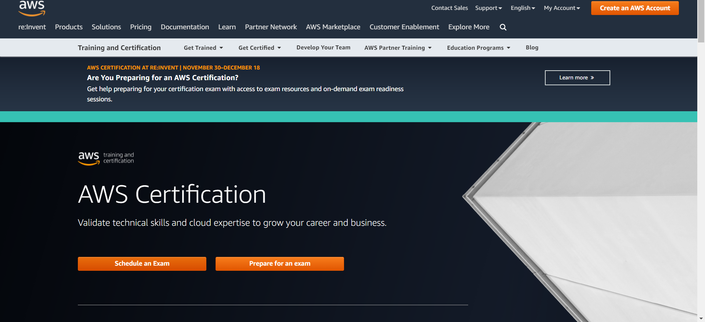
Amazon Web Services Certification Step 1: Go to the AWS Certification Page
Go to the certifications page at: http://aws.amazon.com/certification/
Click ‘Schedule an Exam’

Slide 14
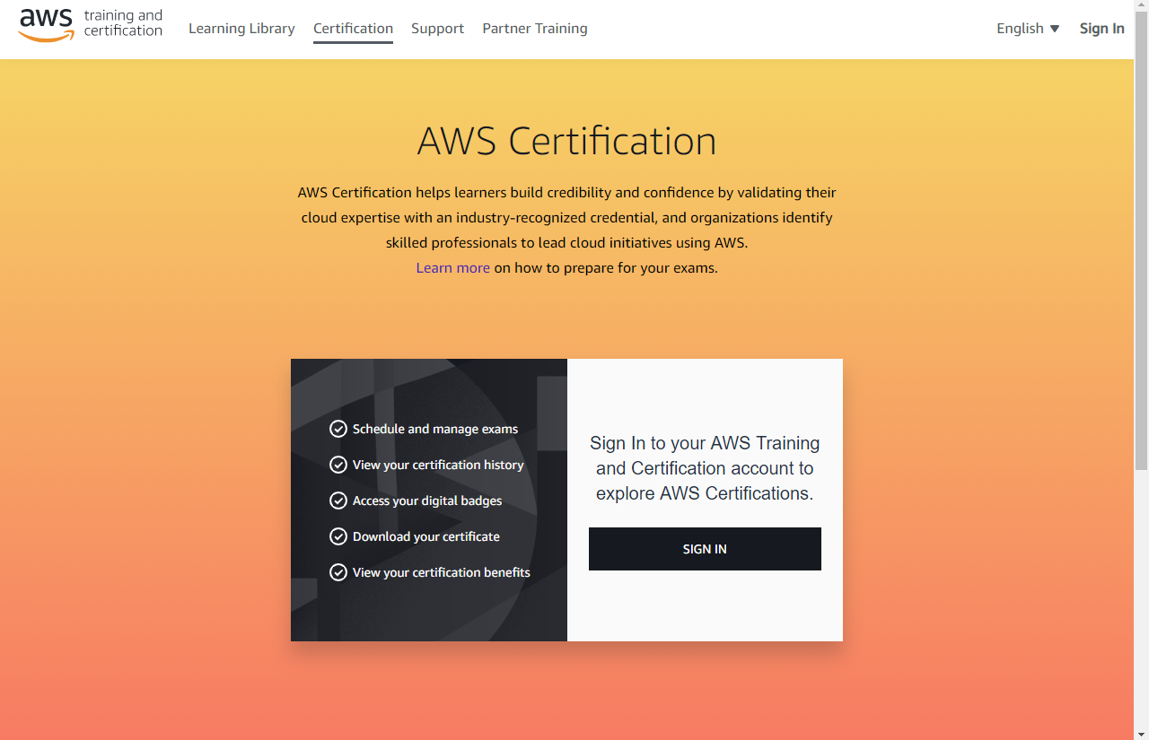
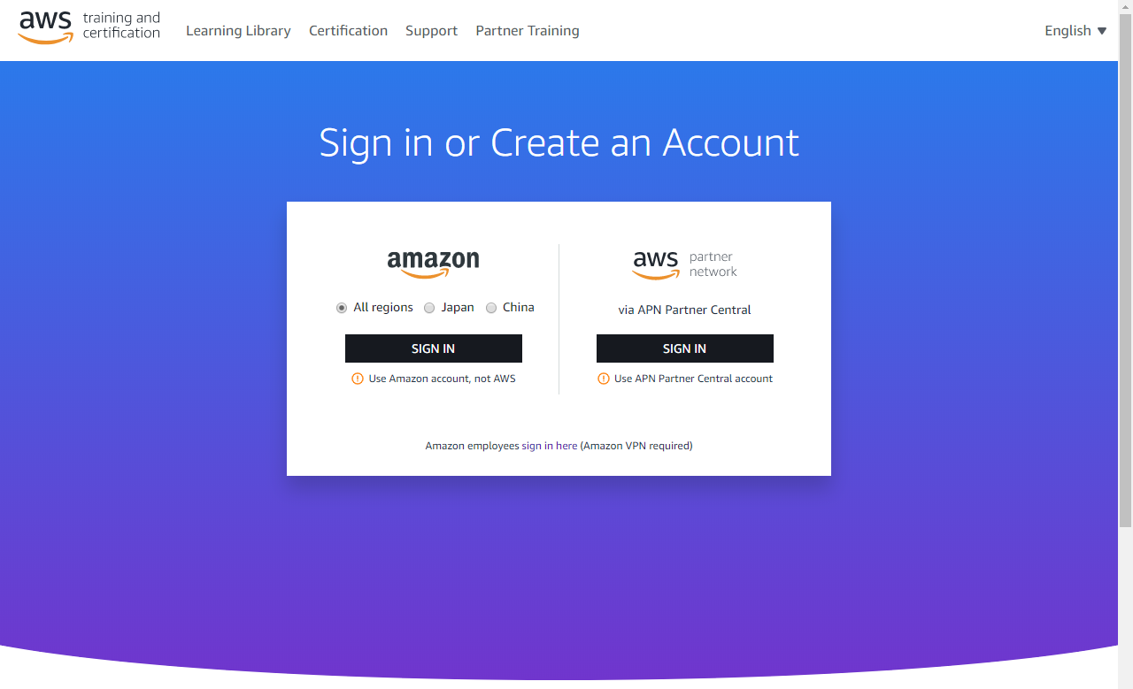
Amazon Web Services Certification Step 2: Login to the AWS Certification Website
Click the ‘Sign in’ button to use either your Amazon retail account or your APN Partner Central Account (recommended)
Click the ‘Sign in’ button

Slide 15
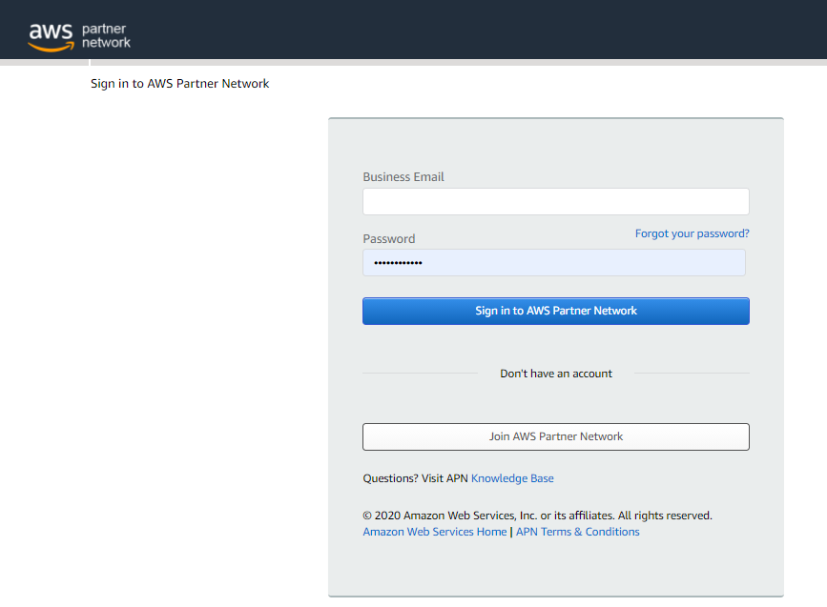
Amazon Web Services Certification Step 3: Sign in or Create a New Account at AWS
:
1) If you have a partner portal account, you should sign in by clicking ‘Sign in’.
2) If you do not have a partner portal account, you should create one and use those credentials to log in to the certification site.
To create a partner portal account, click ‘Create New Account’ and follow the instructions. If you are unable to create a partner portal account, you may be able to use an existing AWS retail account to sign in per the prior screen, step 3a.

Slide 16
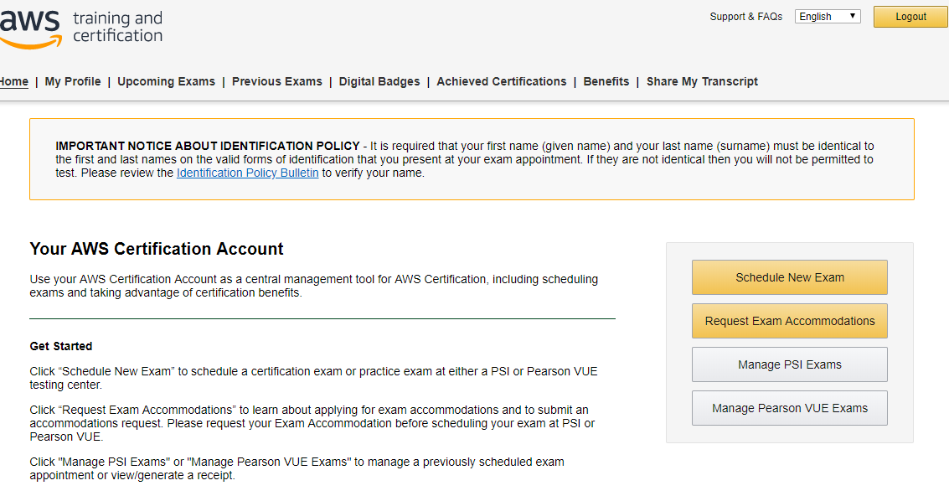
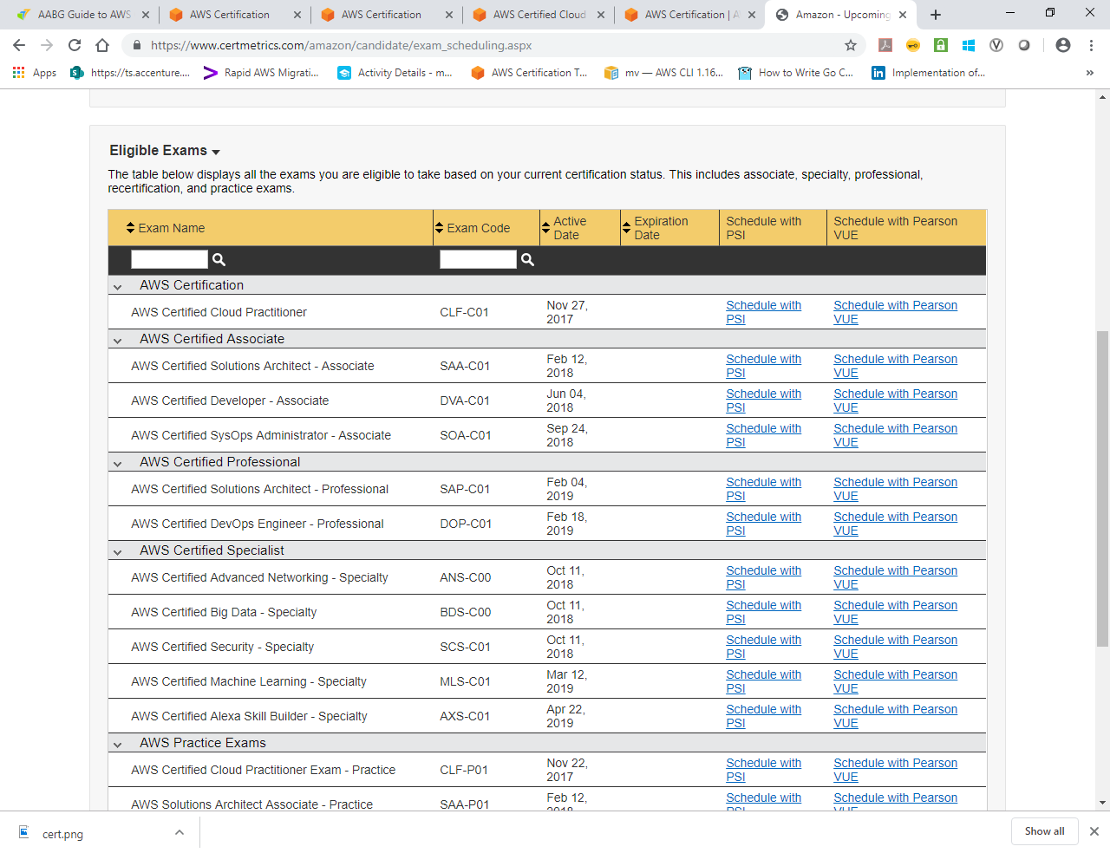
Amazon Web Services Certification Step 4: Schedule your exam
Once you’re logged in to your certification account you can schedule and manage your exam.
To schedule a practice or final exam:
Click Schedule New Exam
You will be presented with a scrolling list of available exams.
Select the exam you wish to schedule by clicking ‘Schedule Exam’. Please note that you will have the option to schedule with either PSI or Pearson Vue…if you will be using a voucher, be sure to select the provider indicated for your voucher.

Slide 17
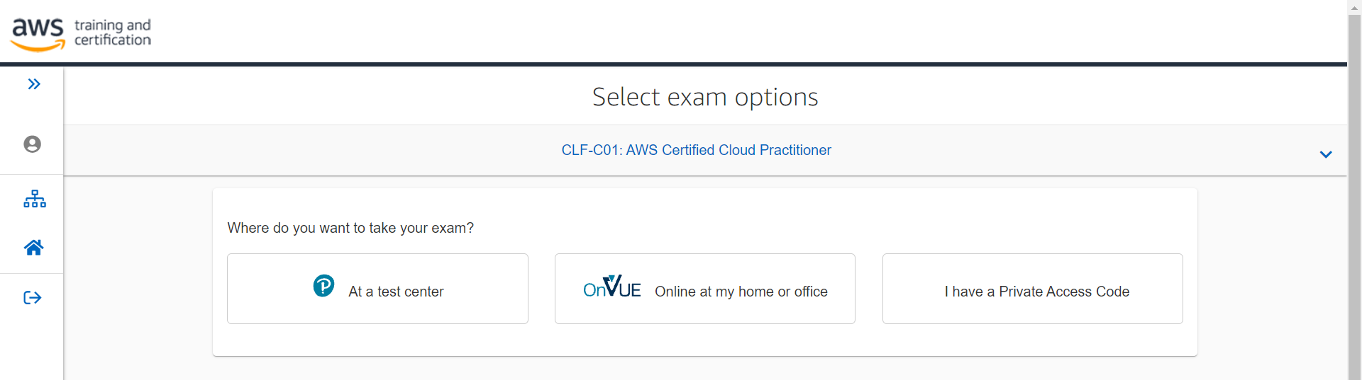
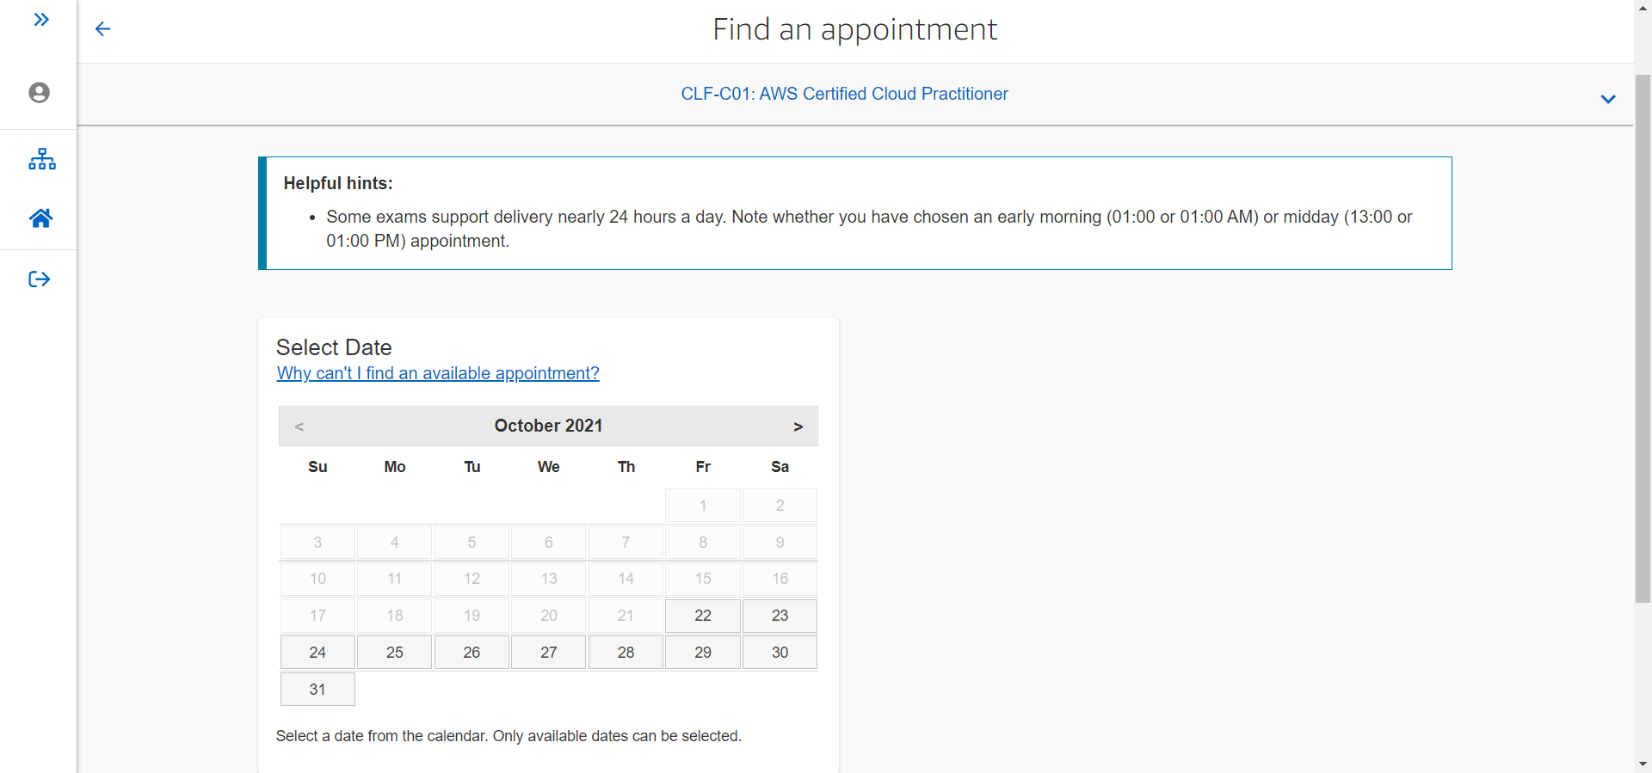
Amazon Web Services Certification Step 5: Complete Registration
Select how you wish to take the exam
Review the guidance presented for your choice and click next.
Review the policies, check acknowledgement boxes and click ‘Agree’
Select the language as requested
Select a date and time for your exam
Confirm the selection and Proceed to Checkout
At checkout, enter the voucher code provided by Accenture
After entering the voucher as payment, submit.
You will receive an email confirming the details of your exam

Slide 18
Pass your exam and register in mycredential system

Slide 19
Pass your exam and register in myCredential
Once you have successfully passed your certification exam, you should:
Login into https://mycredential.accenture.com
In the search box, enter ‘Amazon’
Under the list of available certifications, choose the certification that you have successfully obtained and click ‘Register’
Click the ‘Components’ tab
Expand the ‘Evidence of Certification’ section and click the ‘Evidence of Certification’ component appearing within this section
Complete and submit the Evidence of Certification (EoC) form. Please note that your AWS Validation Number should be entered in the ‘AWS certification number’ field.
After submitting the EoC form, your request will be sent for approval by the myCredentials team. Upon approval of your submission, the following will take place:
Your completion status will be updated within three business days.
Your credential will appear in your Accenture CV-Resume within two weeks after the month end close.
Your credential will be added to your People Page within two weeks after month end close.
If you have any questions, please reach out to the ‘Contact Us’ option on the right side of the myCredential page.

Slide 20
CONTACTS

Slide 21
Amazon Web Services Certification
The following resources are available for questions:
AABG Training and Certification microsite
Certification Exam Vouchers (AWS_Voucher_Dist@accenture.com)
A Cloud Guru (Learning.Vendor.Mgmt@accenture.com)
AABG, Partner Programs Lead (jeffrey.s.s.hammond@accenture.com)

